Slide 1
Web Traffic Forecasting
Taxonomy Ad Pricing Analysis

Slide 2
Key Findings and Recommendations
Key Findings
Daily volume of page views is very “noisy”
The general trend of page views over the past three years has been slowly decreasing
There are many patterns of time series trends across taxonomies
Some taxonomies can be forecasted accurately, others are more difficult
Recommendations
Advertising on taxonomies with clear trends and seasonality have reason to be priced depending on the forecasted volume of page views
Invest resources into further developing forecasting methods that are accurate across more taxonomies

Slide 3
Exploratory Data Analysis
Data Description:
The data has 132K records and 4 columns:
taxonomy has 136 unique values
page_type has two values, CLP and PLP, which denote different types of landing pages; the difference could be meaningful from an advertising perspective, but the aim of this analysis is to study and forecast web traffic, and both page types are web traffic; only 4 taxonomies were associated with both page types, all others were associated with only one page type -> this column will be discarded from the analysis
week_start_date is the activity date; week_start_dates occur every day from 1/1/2021 to 1/21/2024 (with no missing dates during that range) rather than once every seven days -> it seems better to remove ‘week_start’ from the column label; I relabled it ‘traffic_date’
page_views is the number of views per day per taxonomy per page_type

Slide 4
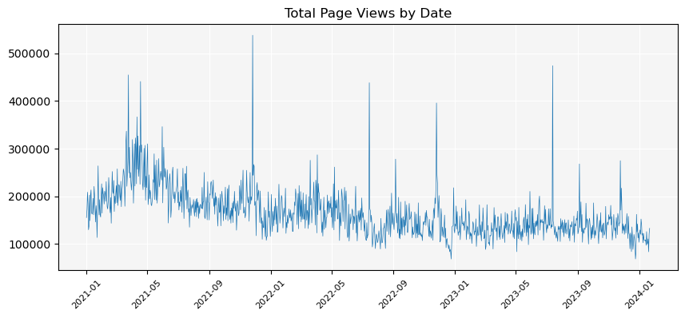
EDA - Visualize and Summarize
Statistics of page_views
count 131647.000000
mean 1393.746967
std 4002.288147
min 0.000000
25% 43.000000
50% 252.000000
75% 1071.000000
max 344923.000000
Column data types:
taxonomy object
page_type object
week_start_date datetime64[ns]
page_views int64
Observations and commentary on page views over time: there is a generally decreasing trend of page views over the past 3 years; seasonality does not appear to be very pronounced; there are a handful of days with significant spikes in volume of over 400K while the mean is close to 150K

Slide 5
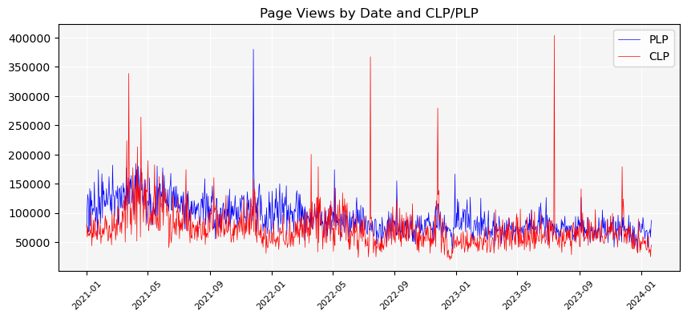
EDA - Visualize and Summarize
PLP vs. CLP record counts:
PLP 81945
CLP 49702

Slide 6
EDA - Missing Values and Anomalies
Missing Values
The data does not have missing values, but some taxonomies have gaps between traffic dates
21K traffic date “gaps” or “hidden” missing values
Some taxonomies are missing many observation dates between the first date of observation (1/1/2021 for most, but later for some) and the last date (1/21/2024)
Anomalies
Some taxonomies have spikes in daily page views; these do not appear to be errors, but can have an impact on forecasting models
Some taxonomies have very low numbers of daily page views

Slide 7
Data Preprocessing - Filtering Taxonomies
The Filters
Taxonomies with over 30% missing observation dates between the first observation date and the end date (1/21/2024) will be filtered out
Taxonomies with a maximum daily page view count of less than 5 will be filtered out

Slide 8
Missing Values and Anomalies
Missing Values
After filtering, taxonomies with missing observation dates were imputed using linear interpolation.
Anomalies
1% of the most-extreme page views per taxonomy were adjusted using an Isolation Forest model.

Slide 9
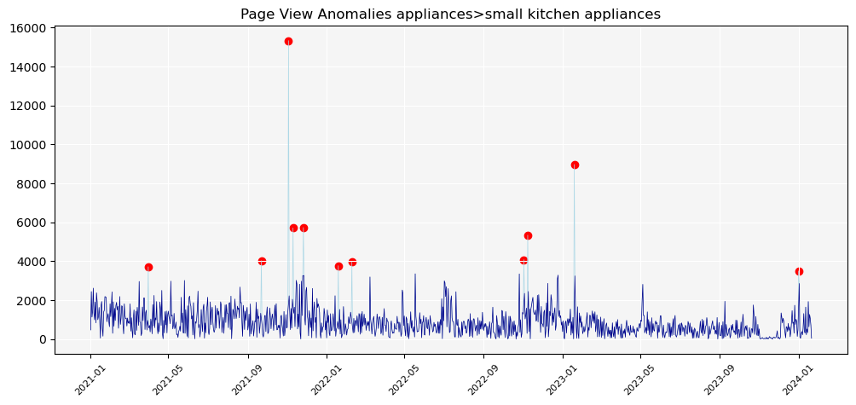
Anomaly Identification Example

Slide 10
Feature Engineering
Date Features
Year
Month
1/2 Month (1-15 of month is one half, 16-EOM is second half; numbered from 1 to 24 over a year)
Day of week (Monday = 0, …, Sunday = 6)
Weekend indicator
Days before Christmas
Days before 4th of July
Page View Features
Lag 1 day, 7 days and 30 days
7-day and 30-day moving averages
7-day MA lag 1 day, 7 days, and 30 days
30-day MA lag 1 day, 7 days, and 30 days

Slide 11
Transformation
Page Views
A Box-Cox transformation was applied to page_view + 1. This was primarily for feeding into an ARIMA model.

Slide 12
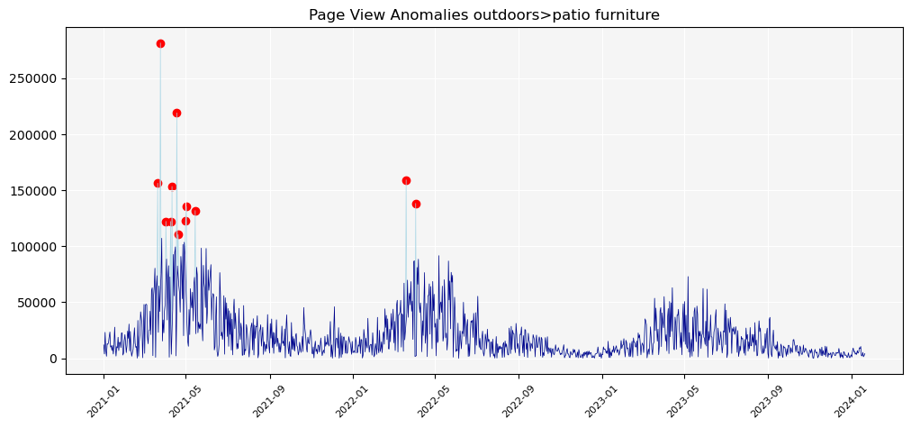
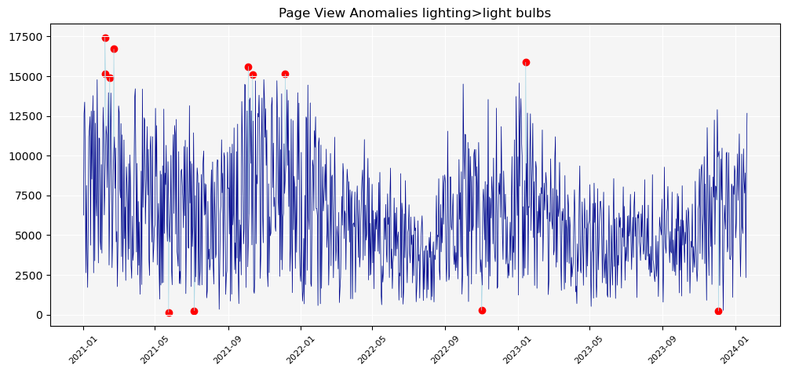
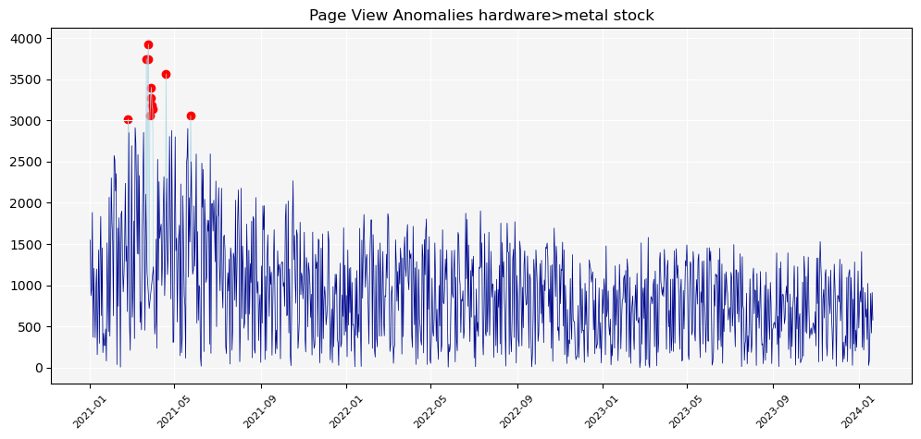
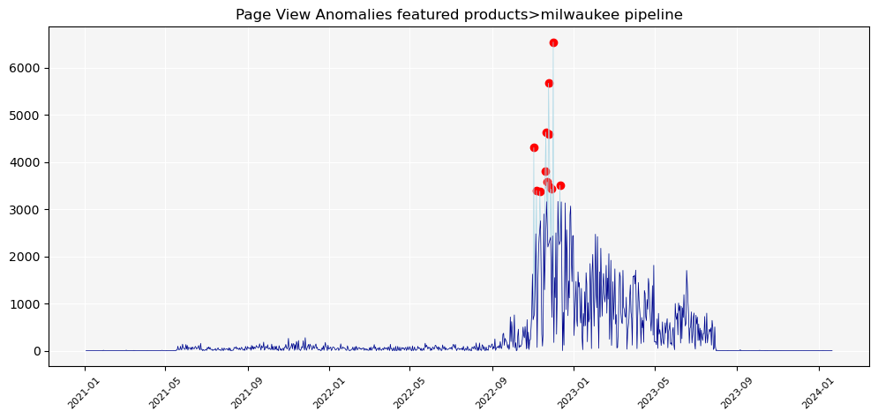
Sample of Time Series Patterns (Very “Noisy”)

Slide 13
Model Selection
LightGBM
Many of the top-performing models in the M5 competition were LightGBM models; this seems like a good model to use.
ARIMA
This model generally performs well. I will use an Auto ARIMA algorithm.
Facebook Prophet
This model is easy to implement, so I will use it as well.
Final Model Choice
All three models will be applied to each taxonomy where the last 6 months of actuals will be used as a test set. The model with the lowest MAPE per taxonomy will be run on all the actuals to produce the forecast for the next 6 months.

Slide 14
Modeling Details
Time Period
The models were created using the daily page view data. The last 6 months were used as a test set and all the data before that was used in the training set.
Champion
To find the champion for each taxonomy, the forecasts on the 6-month test set were aggregated at a weekly level and then the MAPE was calculated.
Input Features
All of the engineered date and page-view features were input into the LightGBM. The cleaned page-view counts were input into the Prophet model. The Box-Cox transformed page-view counts were input into the Auto ARIMA model.

Slide 15
Modeling Details Continued
Prediction Intervals
All three models provide prediction intervals. I used 80% prediction intervals. Forecasts were done at a daily level and then aggregated to the weekly level. I used a heuristic to get the prediction intervals at the weekly level by finding the maximum percent difference between the lower and the upper intervals and applying those percentages to the weekly forecasts to get weekly prediction intervals.
Hyperparameter Tuning
The Auto ARIMA algorithm finds optimal hyperparameters. No tuning was done on the Prophet or LGBM models.

Slide 16
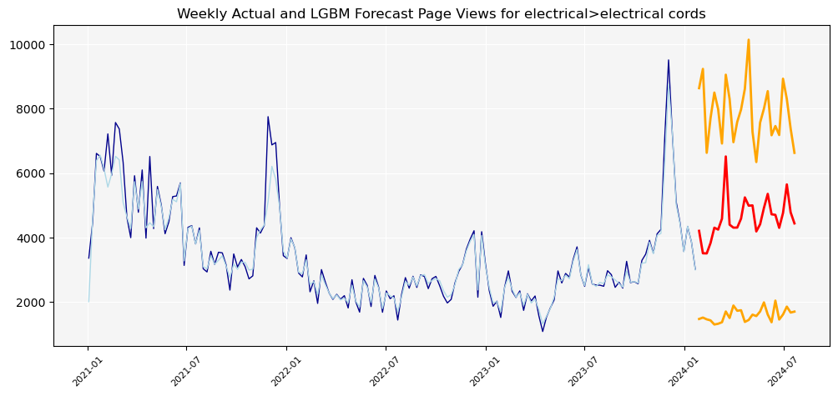
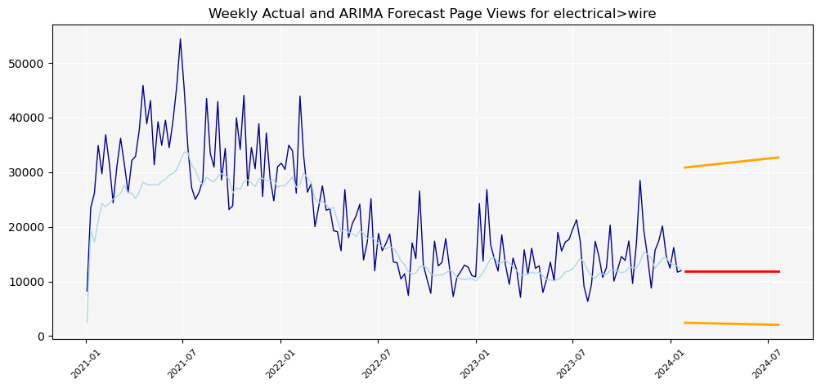
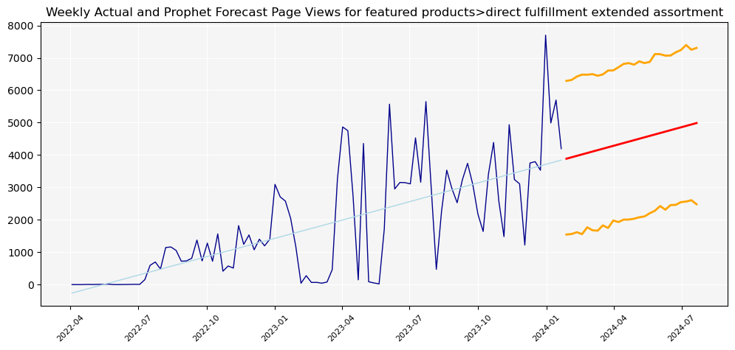
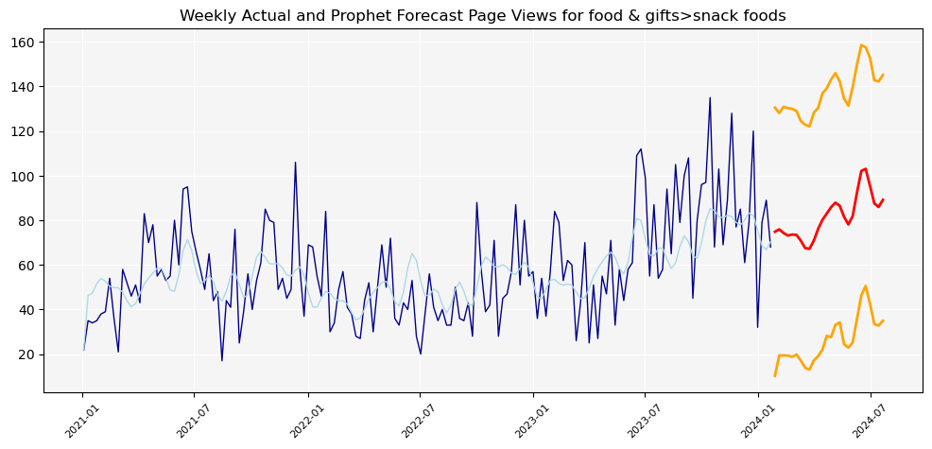
Sample of Forecast Results Visualized

Slide 17
Forecast Results
A total of 104 taxonomies were fit with a forecasting model. 48 of those had an ARIMA model, 28 had an LGBM model, and 21 had a Prophet model.
The forecasts for every taxonomy that had an ARIMA model were essentially flat lines. More investigation should be done to ensure that ARIMA forecasts do a better job at incorporating trend and seasonality.
The confidence intervals all seemed very wide.

Slide 18
Improving the Forecasts
If I were to work on this project to further improve the forecasts, I would do the following:
Model and forecast the 7-day moving average of page views rather than the “raw” counts
Aggregate page views per week and then model and forecast the weekly counts
Input engineered date features into the ARIMA model (making it a SARIMAX model)
Input engineered features into the Prophet model
Do more hyperparameter tuning
Investigate other potential time series models

